Slide 1
6. Practice session 6.1. Overview
Exercise 1&2
Sense: example of Python making a request to temperature and energy “sensor” (a web API as example)​
Description: get and print the wanted data from the “sensors”.
Reference: https://www.weatherapi.com/api-explorer.aspx#history
https://andmed.stat.ee/en/stat/search?searchquery=Production%20of%20electricity
Exercise 3
Integration : An online chair designer.
Description : user input, check if manufacturable, output the model and visualized.
Exercise 4
Control: Use Advanced REST client to control a remote “machine” (http://escop.rd.tut.fi:3000/fmw).
Description: control the virtual machine to assembly a phone in different combination (Frame, Screen, Keyboard).
Reference: http://escop.rd.tut.fi:3000/instructions

Slide 2
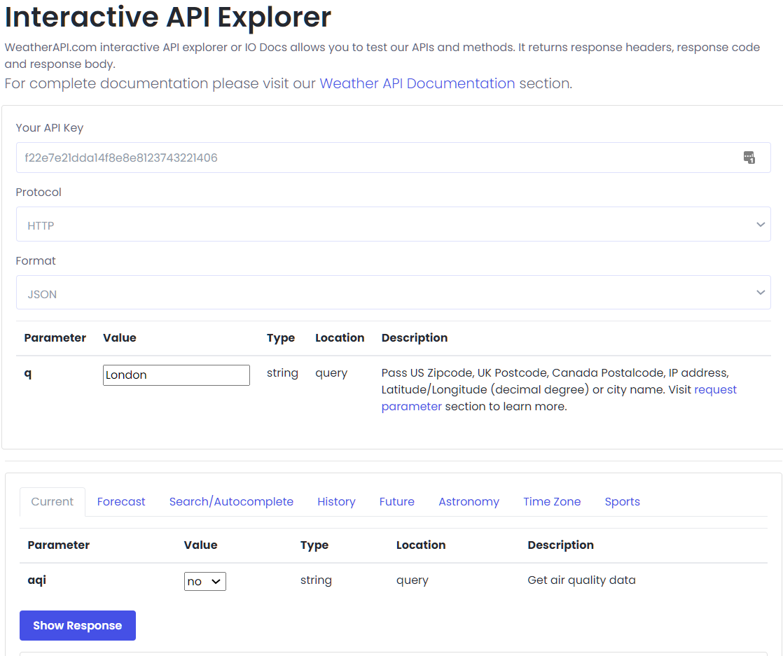
6. Practice session 6.2. Exercise 1
Sense: example of Python making a request to a temperature “sensor” (a web api as example)​
Description: get and print the average temperature.
Reference: https://www.weatherapi.com/api-explorer.aspx#history
Call
http://api.weatherapi.com/v1/current.json?key=f22e7e21dda14f8e8e8123743221406&q=Trondheim&aqi=no
Response Body
{ "location": { "name": "Trondheim", "region": "Sor-Trondelag", "country": "Norway", "lat": 63.42, "lon": 10.42, "tz_id": "Europe/Oslo", "localtime_epoch": 1655213779, "localtime": "2022-06-14 15:36" }, "current": { "last_updated_epoch": 1655213400, "last_updated": "2022-06-14 15:30", "temp_c": 14.0, "temp_f": 57.2, "is_day": 1, "condition": { "text": "Partly cloudy", "icon": "//cdn.weatherapi.com/weather/64x64/day/116.png", "code": 1003 }, "wind_mph": 5.6, "wind_kph": 9.0, "wind_degree": 210, "wind_dir": "SSW", "pressure_mb": 1015.0, "pressure_in": 29.97, "precip_mm": 0.0, "precip_in": 0.0, "humidity": 67, "cloud": 75, "feelslike_c": 14.5, "feelslike_f": 58.0, "vis_km": 10.0, "vis_miles": 6.0, "uv": 3.0, "gust_mph": 3.1, "gust_kph": 5.0 } }
Fig. screenshot of https://www.weatherapi.com/api-explorer.asp

Slide 3
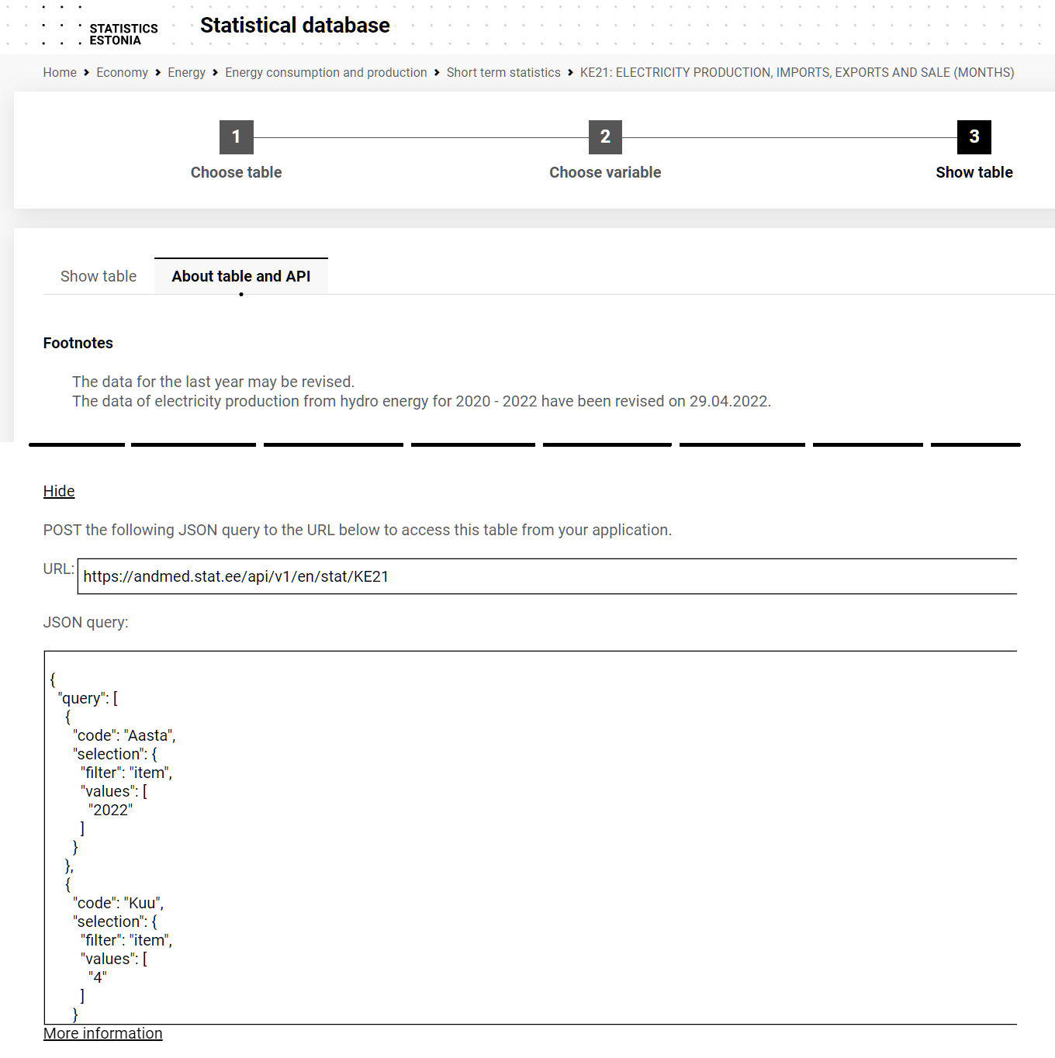
6. Practice session 6.3. Exercise 2
Sense: example of Python making a request to an energy “sensor” (a web api as example)​
Description: get and print the energy data. (Electricity production total/GWh, Imports of electricity/GWh, Exports of electricity, GWh)
Reference: https://andmed.stat.ee/en/stat/search?searchquery=Production%20of%20electricity
Call
https://andmed.stat.ee/api/v1/en/stat/KE21
Response Body
{"class":"dataset","label":"KE21: ELECTRICITY PRODUCTION, IMPORTS, EXPORTS AND SALE by Year, Month and Indicator","source":"Statistics Estonia","updated":"2009-01-08T07:00:00Z","id":["Aasta","Kuu","Näitaja"],"size":[1,1,3],"dimension":{"Aasta":{"label":"Year","category":{"index":{"2022":0},"label":{"2022":"2022"}}},"Kuu":{"label":"Month","category":{"index":{"4":0},"label":{"4":"April"}}},"Näitaja":{"label":"Indicator","category":{"index":{"1":0,"4":1,"5":2},"label":{"1":"Electricity production total, GWh","4":"Imports of electricity, GWh","5":"Exports of electricity, GWh"}}}},"value":[591,651,436],"role":{"time":["Aasta"]},"version":"2.0","extension":{"px":{"tableid":"KE21","decimals":0}}}
https://andmed.stat.ee/en/stat/majandus__energeetika__energia-tarbimine-ja-tootmine__luhiajastatistika/KE21/table/tableViewLayout2

Slide 4
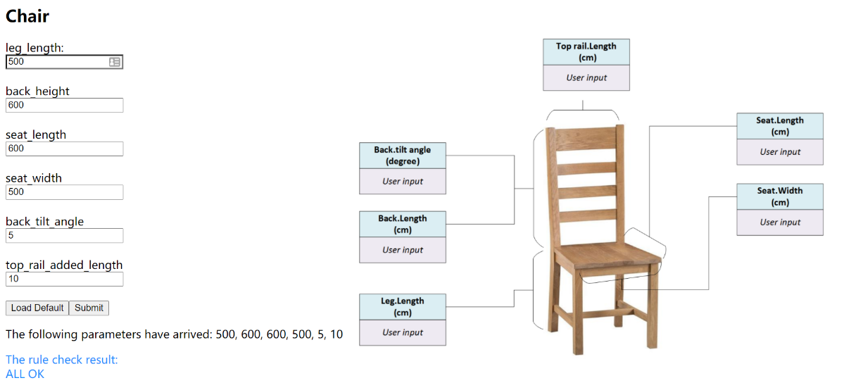
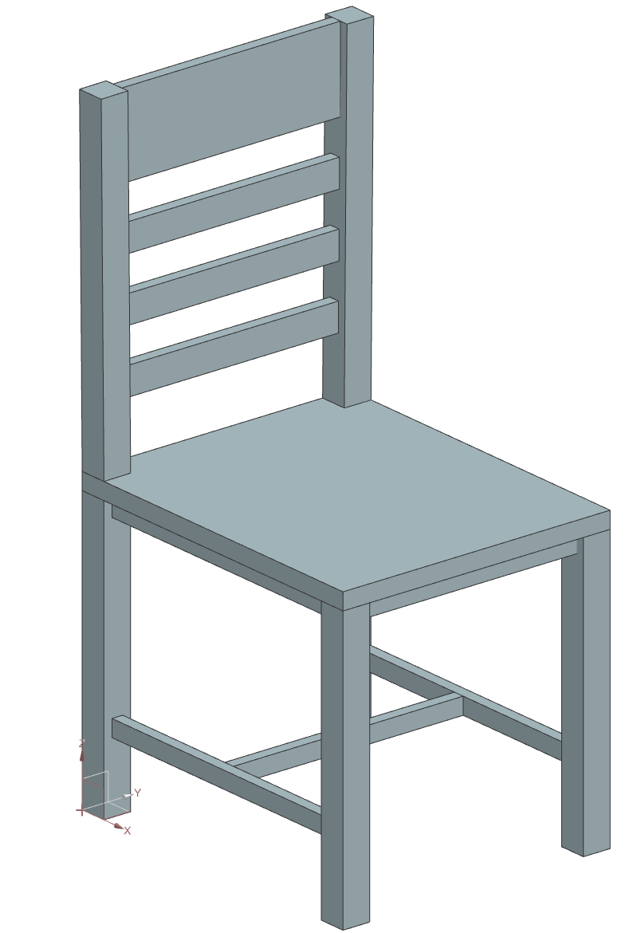
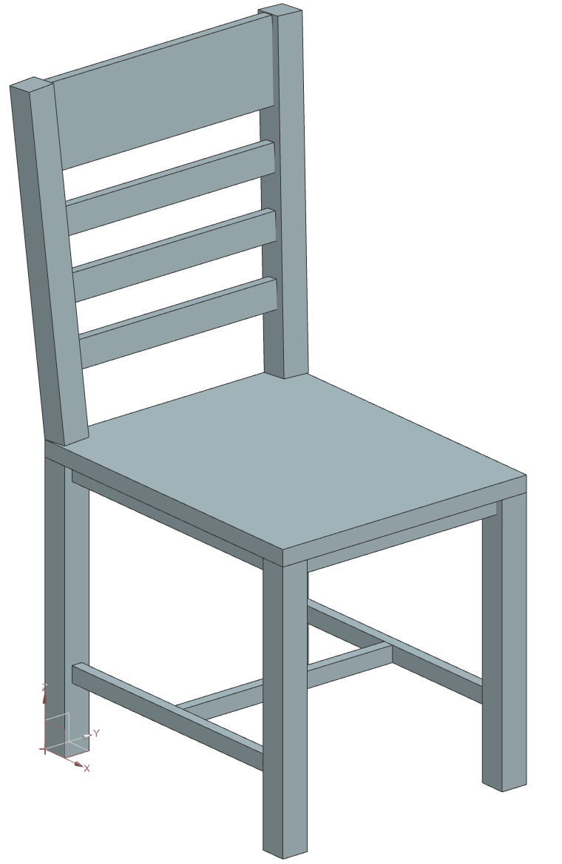
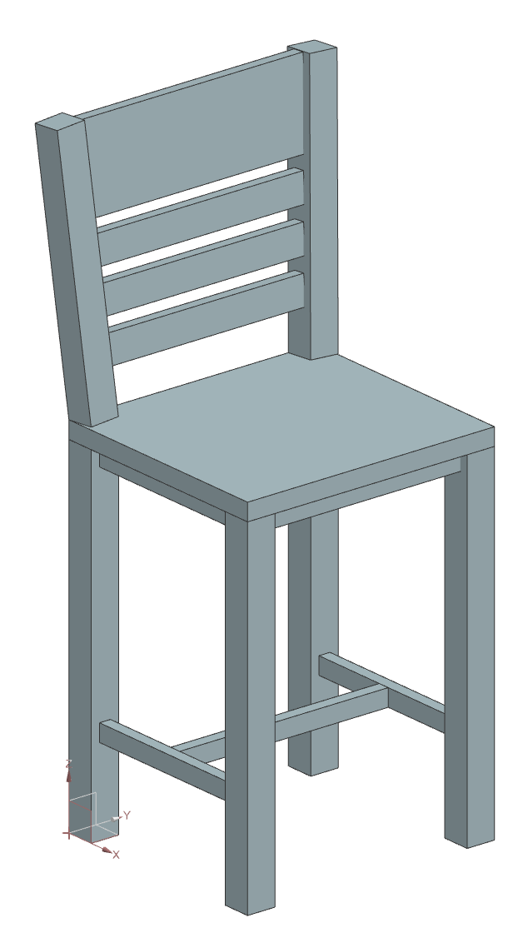
6. Practice session 6.4. Exercise 3
Integration : An online chair designer.
#! NX/KF 4.0
DefClass: chair_zzz (ug_base_part);
#Parameters for the chair
(number parameter) large_timble_side: 50;
(number parameter) middle_timble_side: 30;
(number parameter) small_timble_side: 20;
(number parameter) leg_length: 600;
(number parameter) back_tilt_angle: 5;
(number parameter) back_height: 450;
(number parameter) top_rail_added_length: 60;
(number parameter) top_rail_length: seat_width:- 2*large_timble_side: + top_rail_added_length:;
(number parameter) seat_length: 400;
(number parameter) seat_width: 450;
#duduced or other parameters
(number parameter) top_rail_height: 3*large_timble_side:;
(number parameter) leg_side: large_timble_side:;
(number parameter) seat_height: middle_timble_side:;
#the detailed code for components ……
Generate products in DFA code.
Check if manufacturable.
User input
Knowledge Base
(For manufacturable check rules)
The products visualized in Siemens NX.

Slide 5
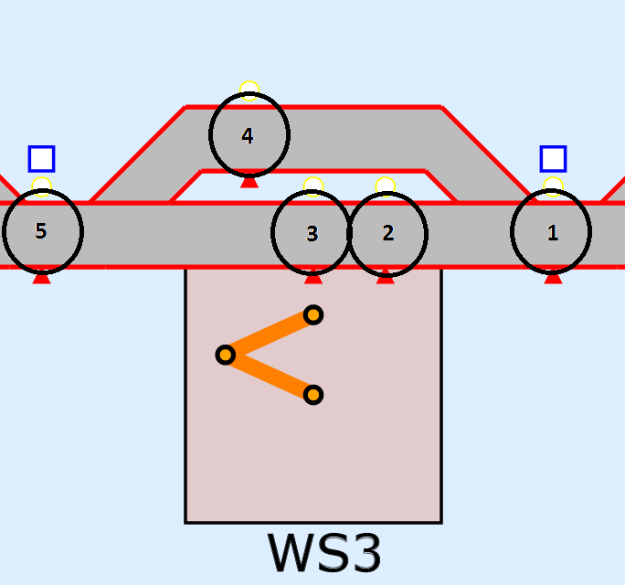
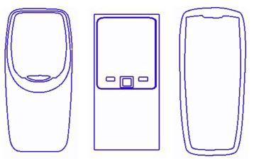
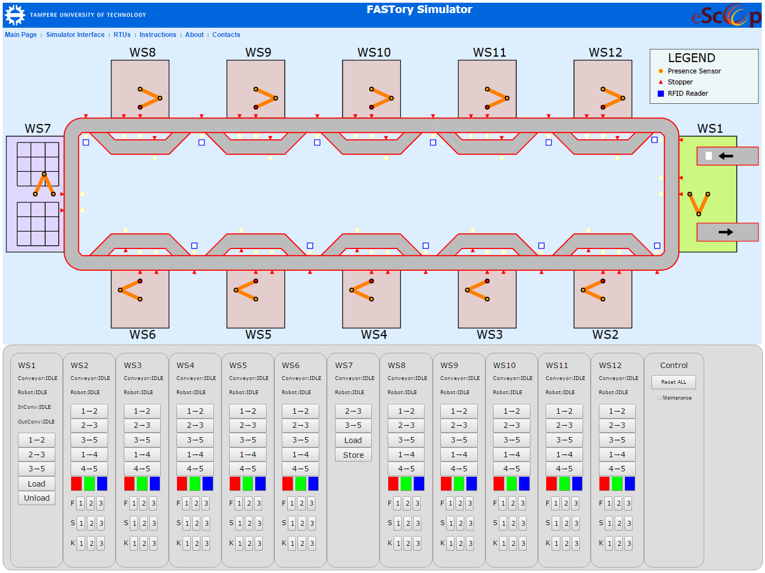
6. Practice session 6.5. Exercise 4
Control: Use Advanced REST client to control a remote “machine” (http://escop.rd.tut.fi:3000/fmw).
Description: control the virtual machine to assembly a phone in different combination (Frame, Screen, Keyboard).
Reference: FASTory Simulator instructions: http://escop.rd.tut.fi:3000/instructions
Async/await: https://en.wikipedia.org/wiki/Async/await
The process description:
The production starts in WS7 by LoadPallet, after that the pallet must reach WS1 to get paper by LoadPaper, then the pallet goes to WS2-6, 8-12 for drawing mobile phone on it, the drawing has three parts; Frame, Screen and Keyboard.
Each part can have red, green or blue colour and each part has recipe number (1-9).
After that the pallet must go again to WS1 for removing the paper by UnloadPaper and finally pallet goes to WS7 for Unloading the pallet.
This is one cycle of production life but pallet can stay in the line to get new paper for other product.

Slide 6
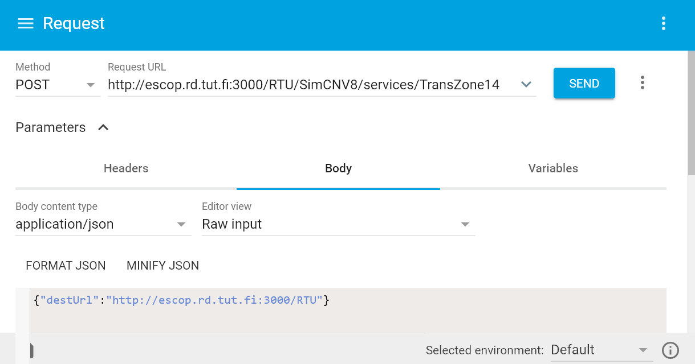
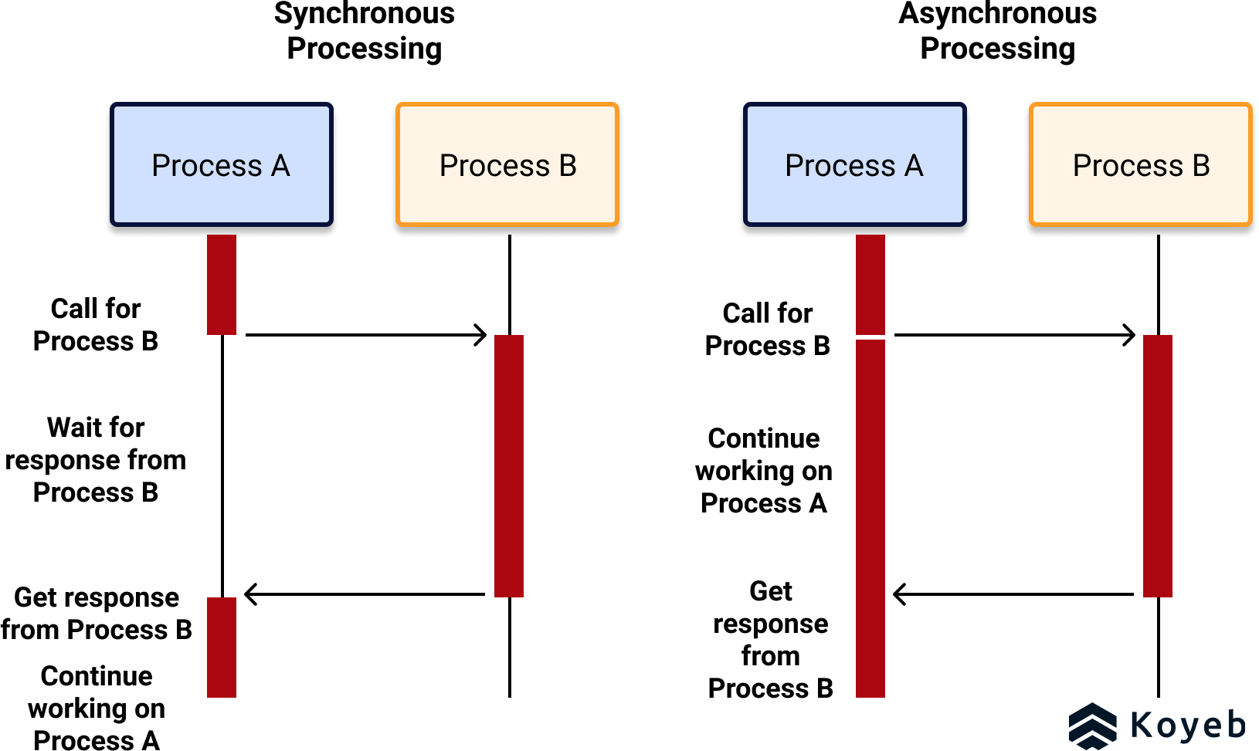
6. Practice session 6.5. Exercise 4
Control: Use Advanced REST client to control a remote “machine” (http://escop.rd.tut.fi:3000/fmw).
Description: control the virtual machine to assembly a phone in different combination (Frame, Screen, Keyboard).
Command example: move from 1 to 4 in WS8
URL: http://escop.rd.tut.fi:3000/RTU/SimCNV8/services/TransZone14
Method: POST, body: {"destUrl":"http://escop.rd.tut.fi:3000/RTU"}
Fig. Introduction to Synchronous and Asynchronous Processing
Source: https://www.koyeb.com/blog/introduction-to-synchronous-and-asynchronous-processing

Slide 7
6. Practice session 6.5. Exercise 4
Control: Use Advanced REST client to control a remote “machine” (http://escop.rd.tut.fi:3000/fmw).
Description: control the virtual machine to assembly a phone in different combination (Frame, Screen, Keyboard).
The energy consumption parameters
(or something else)
Phone parameters
(F.sty, F.clr, S.sty, S.clr, K.sty, K.clr)
F.sty: 1, 2, 3; F.clr: R, G, B;
S.sty: 1, 2, 3; S.clr: R, G, B;
K.sty: 1, 2, 3; K.clr: R, G, B;
3^6 = 729 combinations
The list of Req. URL
URL 1: load
URL 2: move 2 to 3 in WS7
……
Rules
Convertor

